Slide 1
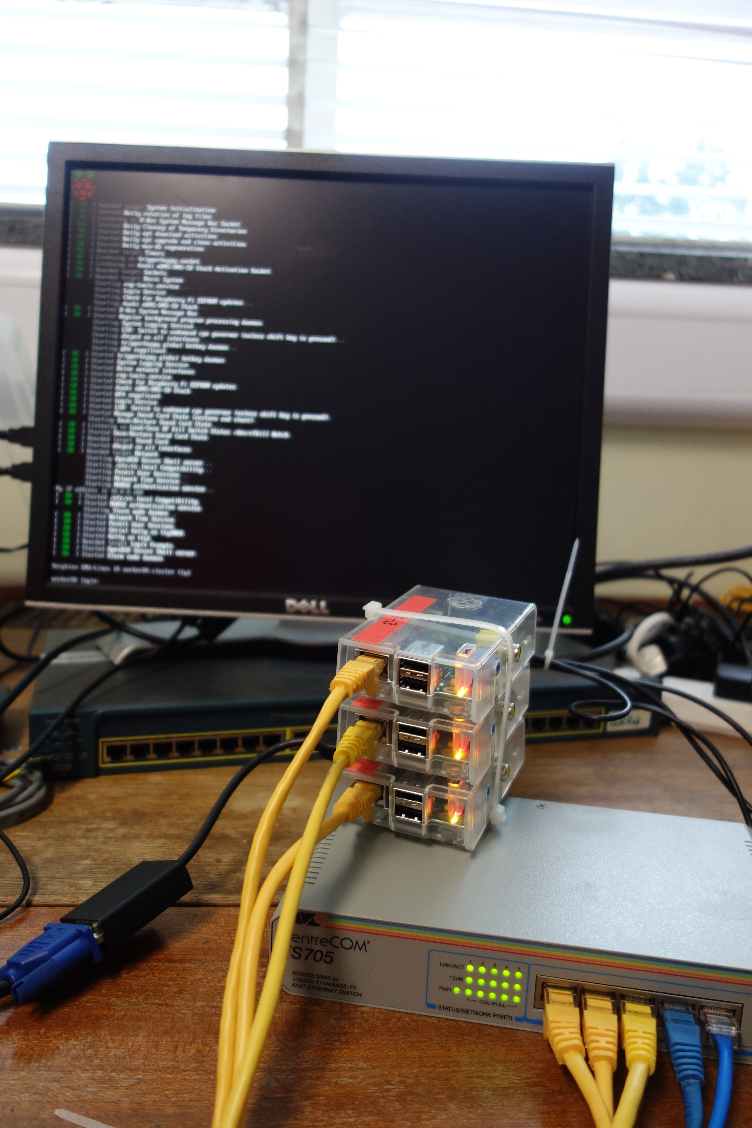


Introducing HPC with a Raspberry Pi Cluster
A practical use of and good excuse to build Raspberry Pi Clusters
Colin Sauzé <cos@aber.ac.uk>
Research Software Engineer
Super Computing Wales Project
Aberystwyth University

Slide 2
Overview
About Me
Inspirations
Why teach HPC with Raspberry Pi?
My Raspberry Pi cluster
Experiences from teaching
Future Work

Slide 3





About Me
Research Software Engineer with Supercomputing Wales project
  4 university partnership to supply HPC systems
  Two physical HPCs
PhD in Robotics
  Experience with Linux on single board computers
  Lots of Raspberry Pi projects

Slide 4
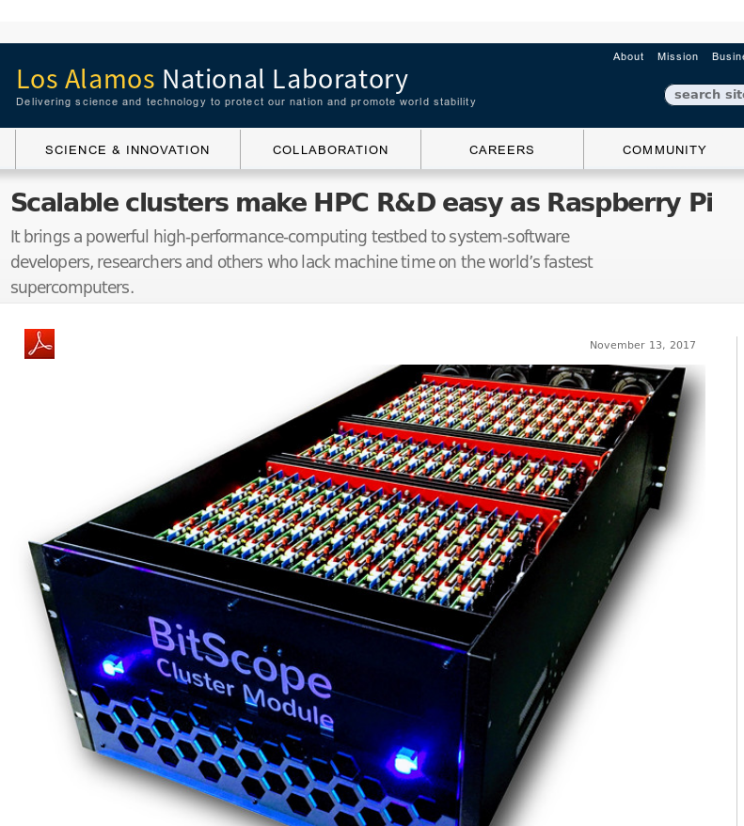
Inspiration #1: Los Alamos National Laboratory
750 node cluster
Test system for software development
Avoid tying up the real cluster

Slide 5
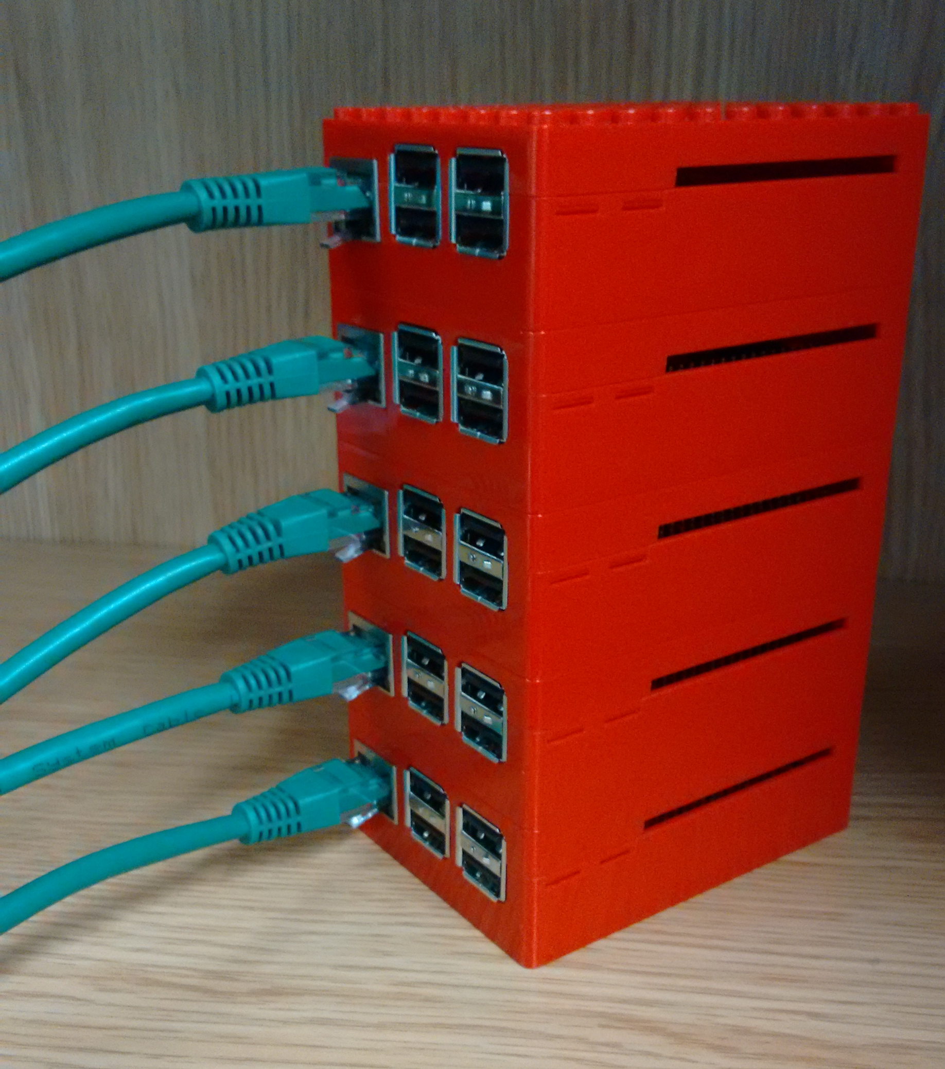
Inspiration #2: Wee Archie/Archlet
EPCC’s Raspberry Pi Cluster
Archie: 18x Raspberry Pi 2’s (4 cores each)
Archlet: smaller 4 or 5 node clusters.
Used for outreach demos.
Setup instructions: https://github.com/EPCCed/wee_archlet
Image from https://raw.githubusercontent.com/EPCCed/wee_archlet/master/images/IMG_20170210_132818620.jpg

Slide 6
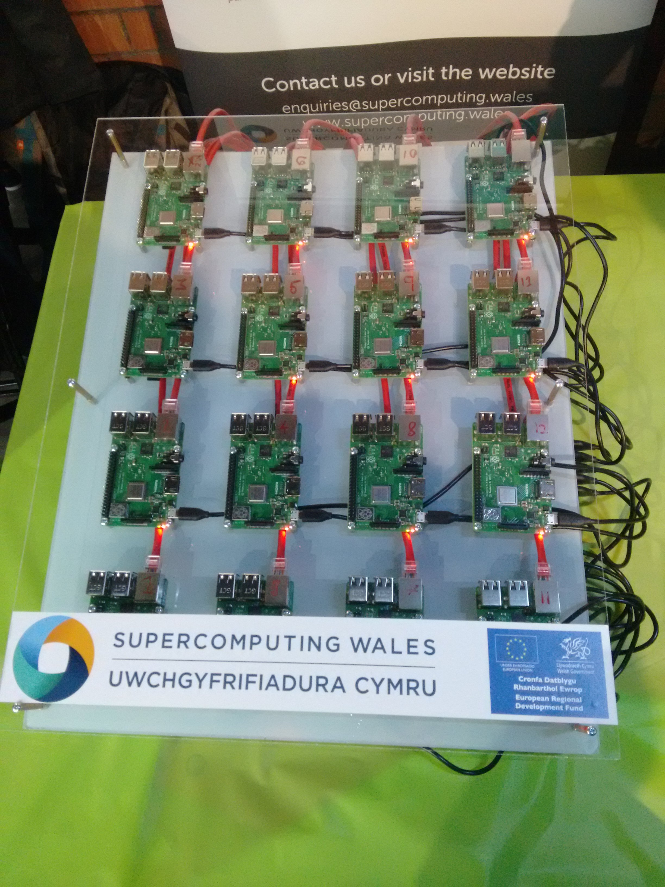
Inspiration #3: Swansea’s Raspberry Pi Cluster
16x Raspberry Pi 3s
CFD demo using a Kinect sensor
Demoed at the Swansea Festival of Science 2018

Slide 7
Why Teach with a Raspberry Pi cluster?
Avoid loading real clusters doing actual research
  Less fear from learners that they might break something
Resource limits more apparent
More control over the environment
Hardware less abstract
No need to have accounts on a real HPC

Slide 8
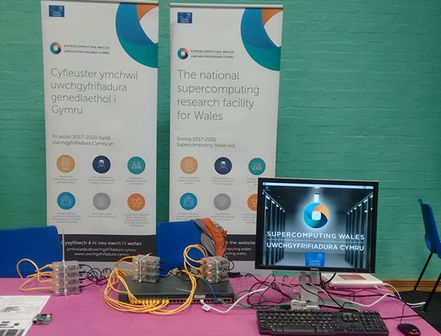
My Cluster
“Tweety Pi”
  10x Raspberry Pi model B version 1s
  1x Raspberry Pi 3 as head/login node
  Raspbian Stretch
Head node acts as WiFi access point
  Internet via phone or laptop

Slide 9
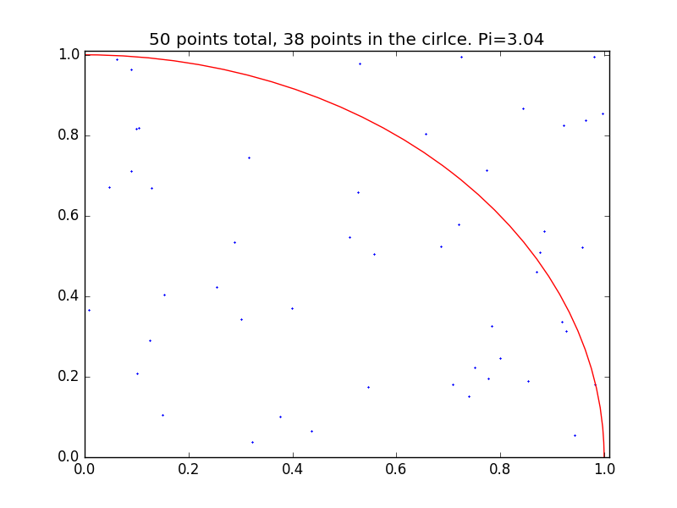
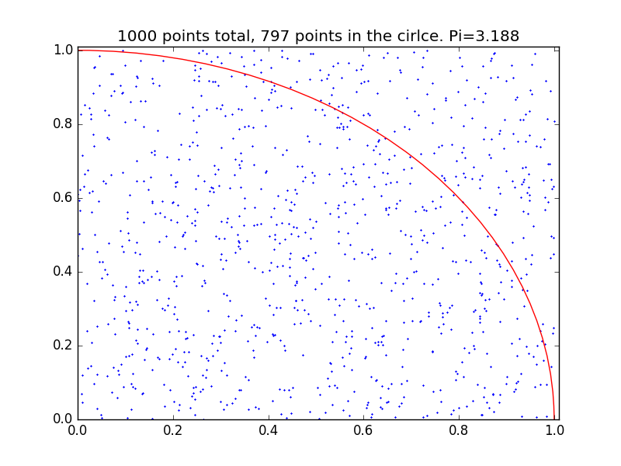
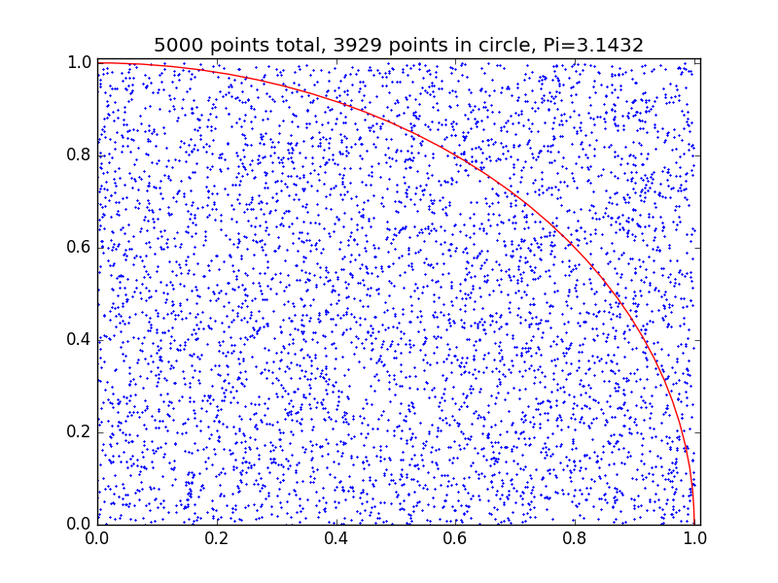

Demo Software
British Science Week 2019
  Simple Pi with Monte Carlo methods demo
  MPI based
  GUI to control how many jobs launch and show queuing
Swansea CFD demo
  Needs more compute power
  16x Raspberry Pi 3 vs 10x Raspberry Pi 1
Wee Archie/Archlet Demos
  Many demos available
    I only found this recently
  https://github.com/EPCCed/wee_archie

Slide 10
Making a realistic HPC environment
MPICH
Slurm
Quotas on home directories
NFS mounted home directories
Software modules
Network booting compute nodes

Slide 11
Network booting hack
No PXE boot support on original Raspberry Pi (or Raspberry Pi B+ and 2)
Kernel + bootloader on SD card
Root filesystem on NFS
  Cmdline.txt contains:
    console=tty1 root=/dev/nfs nfsroot=10.0.0.10:/nfs/node_rootfs,vers=3 ro ip=dhcp elevator=deadline rootwait
SD cards can be identical, small 50mb image, easy to replace

Slide 12

Teaching Materials
Based on Introduction to HPC with Super Computing Wales carpentry style lesson:
  What is an HPC?
  Logging in
  Filesystems and transferring data
  Submitting/monitoring jobs with Slurm
  Profiling
  Parallelising code, Amdahl’s law
  MPI
  HPC Best Practice

Slide 13
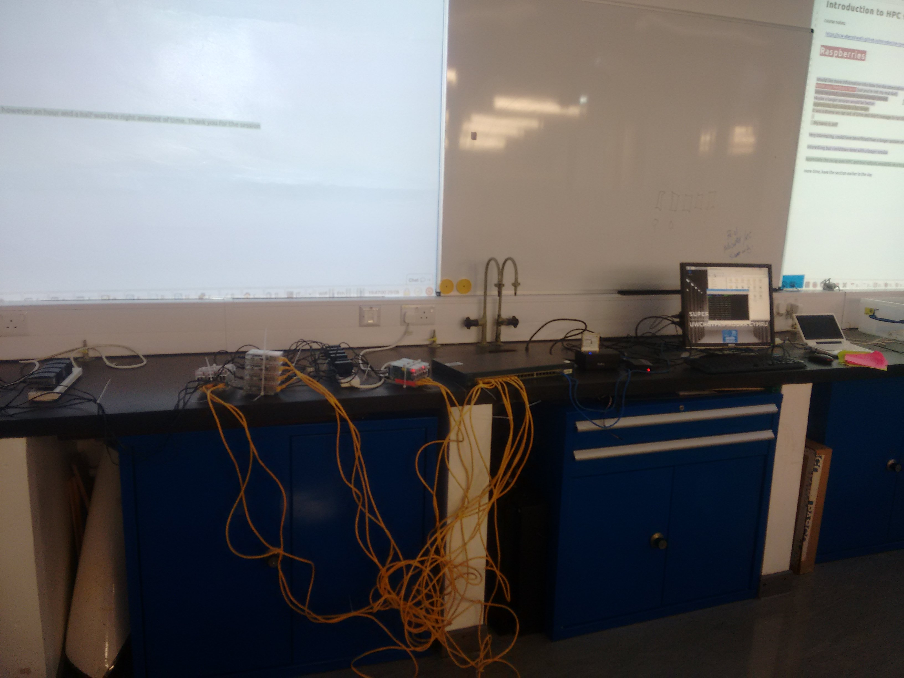
Experiences from Teaching – STFC Summer School
New PhD students in solar physics
  Not registered at universities yet, no academic accounts
15 people each time
  1st time using HPC for many
  Most had some Unix experience
Subset of Super Computing Wales introduction to HPC carpentry lesson

Slide 14
Feedback
Very Positive
A lot seemed to enjoy playing around with SSH/SCP
  First time using a remote shell for some
  Others more adventurous than they might have been on a real HPC
Main complaint was lack of time (only 1.5 hours)
  Only got as far as covering basic job submission
  Quick theoretical run through of MPI and Amdahl’s law
  Probably have 3-4 hours of material
Queuing became very apparent
  10 nodes, 15 users
  “watch squeue” running on screen during practical parts

Slide 15
Problems
Slurm issues on day 1
  Accidentally overwrote a system user when creating accounts
WiFi via Laptop/phone slow
  When users connect to the cluster its their internet connection too
  Relied on this for access to course notes

Slide 16
Experiences from teaching – Supercomputing Wales Training
Approximately 10 people
  Mix of staff and research students
  Mixed experience levels
  All intending to use a real HPC
Simultaneously used Raspberry Pi and real HPC
  Same commands run on both
Useful backup system for those with locked accounts
Feedback good
  Helped make HPC more tangible

Slide 17
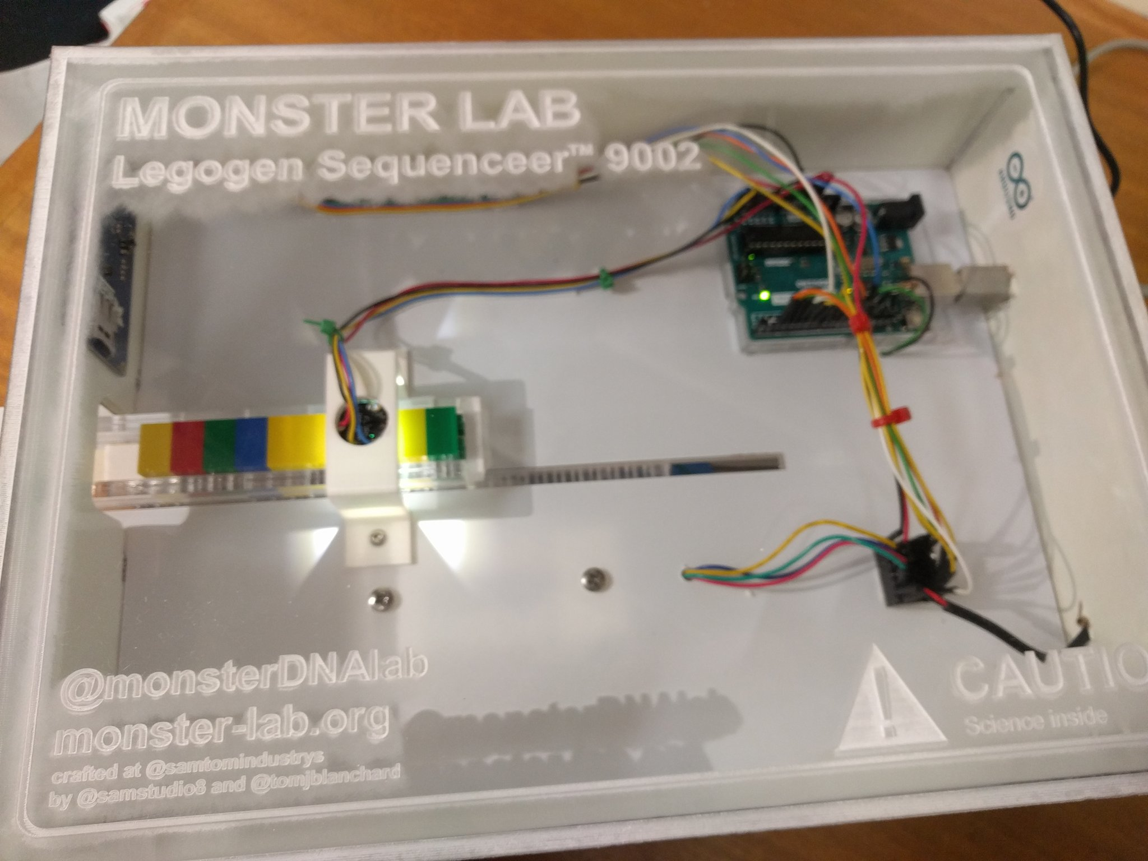
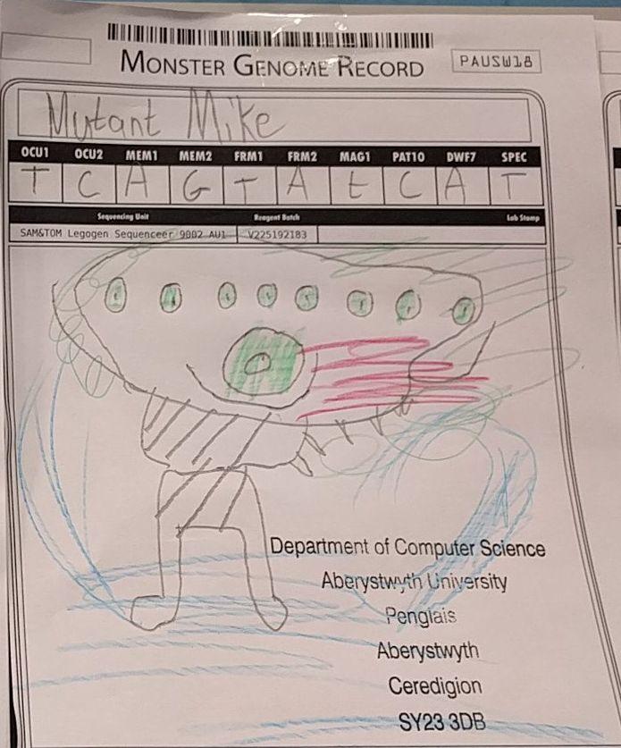
Future Work
Configuration management tool (Ansible/Chef/Puppet/Salt etc) instead of script for configuration
CentOS/Open HPC stack instead of Raspbian
Public engagement demo which focuses on our research
  Analysing satellite imagery
  Simulate the monsters from MonsterLab (https://monster-lab.org/)

Slide 18
More Information
Setup instructions and scripts - https://github.com/colinsauze/pi_cluster
Teaching material - https://github.com/SCW-Aberystwyth/Introduction-to-HPC-with-RaspberryPi
Email me: cos@aber.ac.uk

